Slide 1
Open Rights Group
Censorship Monitoring Project
www.blocked.org.uk
Richard King
richard@openrightsgroup.org
@graphiclunarkid

Slide 2
Background
Concerns about children accessing inappropriate material (pornography, violence, self harm, etc.)
Campaigners convinced mobile operators to filter by default.
Public wifi networks also affected.
Summer 2013 - government pressures ISPs to filter home broadband connections by default.
No legislation, voluntary codes and standards.

Slide 3
How they filter
Private companies are employed to filter sites.
Secret blacklists, keywords, algorithms.
Technology can include DNS interception, DPI.
Requesting a censored site returns a page explaining it is blocked and (sometimes) why.

Slide 4
Problems: filter categories
Screen 1 | Screen 2
Do you want to install / enable parental controls? ☑ Yes ☐ No | Do you want to block: ☑ pornography ☑ violent material ☑ extremist and terrorist related content ☑ anorexia and eating disorder websites ☑ suicide related websites ☑ alcohol ☑ smoking ☑ web forums ☑ esoteric material ☑ web blocking circumvention tools
Categories that are unnecessary or too broad

Slide 5
Problems: overblocking
May 2012: ORG mobile censorship report
TOR website (online anonymity tool)
La Quadrature du Net (digital rights advocacy organisation)
St. Margarets Community Website, Middlesex
Biased-BBC (campaign site)
eHow.com (advice & education site)
The Vault (bar in London)
Yomaraugusto.com (artist portfolio)
Shelfappeal.com (blog)

Slide 6
Problems: overblocking
Jun 2013: a “load of cock” – Claire Perry MP
The Jargon File (hacker culture)
Brains of Steel (a personal blog)
Campaign against political correctness
TheHouseOfSeduction.com (luxury lingerie store)
Mari Thomas Jewellery
ForeverAndEternity.co.uk (gift shop)
Jan 2014: Government working group researches problem

Slide 7
Problems: unintended outcomes
Wrong people get filtering
  Whole household products are indiscriminate
  New ISP products employ “nudge censorship” by preselected filtering and categories at sign up
  Mobile companies assume you're a child
False sense of security
Complaints are dealt with badly
  “Would you like us to switch the filtering off”
No procedures for website owners to check who is blocking them
Proliferation of networks with blocking makes monitoring censorship hard

Slide 8
Other types of filtering
IWF filtering
  Domain is filtered through single IP address with unexpected results.
  Blocking errors hard to correct as blocklist is secret and maintained by IWF and implementation is by ISP; buck-passing occurs.
Copyright filtering
  Court orders allow the copyright owner to specify a list of domains and IPs that serve a particular website (eg, piratebay.org) to the ISPs served the order.
  The block pages do not explain who is responsible for the block and how to complain, (for instance, how to contact the BPI).
  As a result the list is secret, and ISPs cannot correct mistakes without breaking the terms of the order.
These are not our focus though it will be helpful if we learn more about them

Slide 9
Blocked.org.uk
Mobile sites only
Manual verification and reporting
Patchy advice on how to complain about blocked sites

Slide 10
Timeline
Dec 2012: original site launch
May 2012: mobile internet censorship report
Summer 2013: government pressures ISPs
Autumn 2013: ORG volunteers start developing probes
Dec 2014: ORG call to action
Jan 2014: kick-off meeting in London
Feb 2014: ORG appoints project manager

Slide 11
Mission
We want to end the imposition of web blocking by:
holding ISPs and the government accountable
providing a place where people can learn about the real effects of filters
offering mechanisms to report problems
maintaining an open record of online censorship
releasing our code and data under permissive licenses for others to reuse or extend

Slide 12
Project goals
We want all filtering to be optional, opt-in, and to be clear that it is no panacea for parents
We want adults to be free of filtering technologies
We want to show that filtering is dangerous, restrictive and has significant downsides
We want parents to recognise the rights of children to information of all kinds
We want children to know and ask for their right to information and education
However, we are not against all filtering on principle – it is a choice that should be avoided and as limited as possible.

Slide 13
Opportunities
Making the real behaviour of these filters transparent
Help website owners monitor censorship of their sites
Improving processes for correcting censorship mistakes
Improving the supervision of children online
Reducing the potential for infringement of the rights of children
Stimulate and informing public debate
Research & document censorship methods and technologies
Produce code and data that can be reused by others.

Slide 14
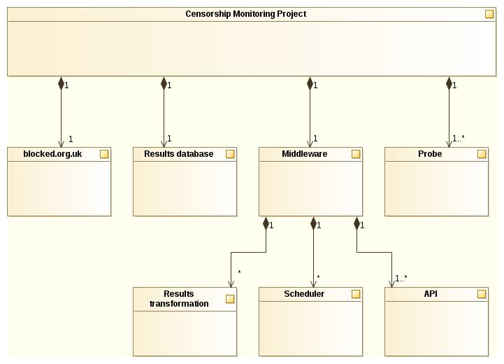
System architecture

Slide 15
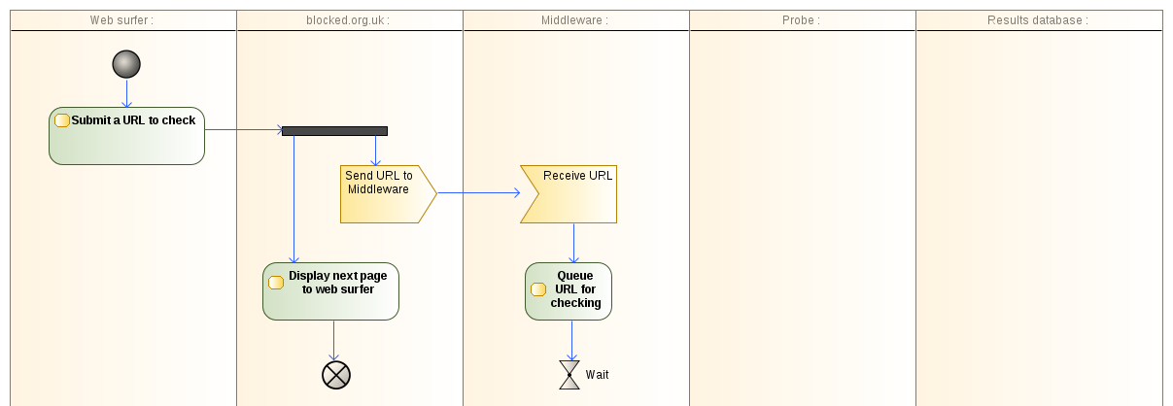
Checking a URL (1)

Slide 16
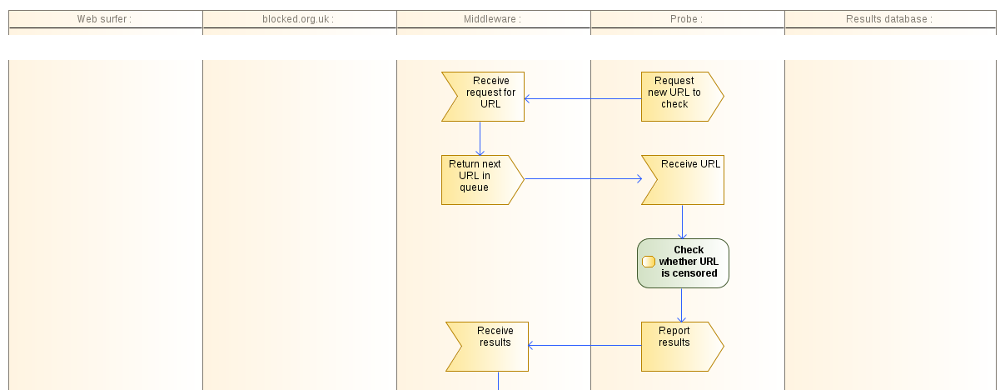
Checking a URL (2)

Slide 17
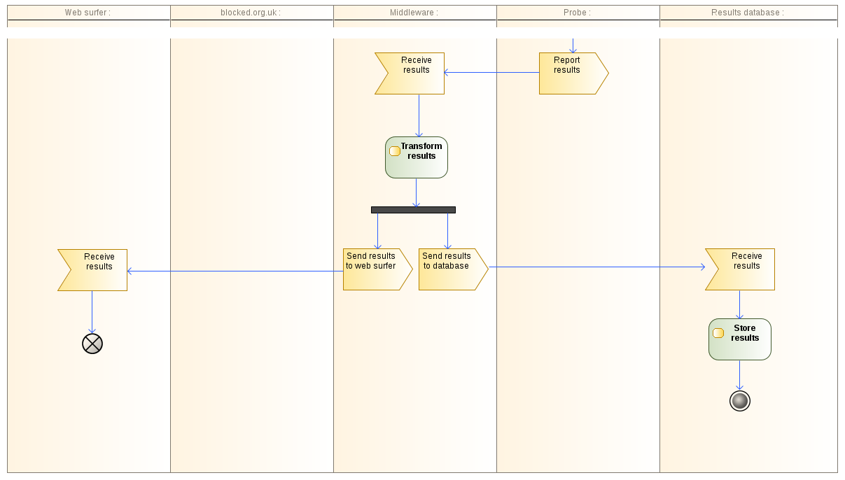
Checking a URL (3)

Slide 18
Probes: OONI - Open Observatory of Network Interference
ooni-probe: Detect surveillance and censorship.
Aim: “share observations and data about the nature, methods, and prevalence of surveillance and censorship around the world, by collecting high quality data using open methodologies and FLOSS.”
Developers: Members of the Tor Project

Slide 19
Probes: OONI
“Lepidopter” Raspberry Pi image
Easily contribute by running an RPi probe.
Distribution Image ready to boot and run tests.
FLOSS Project

Slide 20
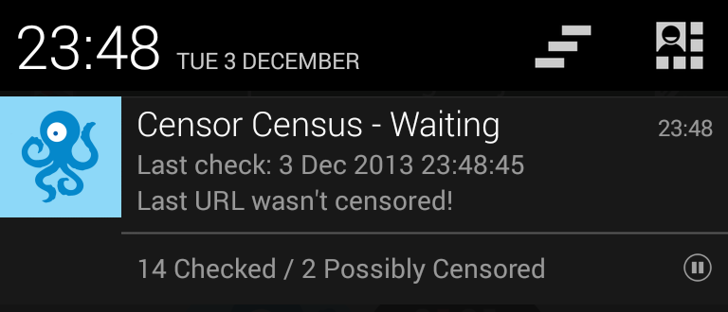
Probes: Android app
WiFi, 3G or LTE connectivity
Lightweight app
Censor Census https://bowdlerize.co.uk/apk/

Slide 21
Sponsors
Bytemark Hosting
  Virtual machines to host middleware & databases
  http://www.bytemark.co.uk/
Andrews & Arnold
  Subscriptions to all major UK ISPs
  Network infrastructure
  Server with VMs to run probes
  http://www.aaisp.net/

Slide 22
Get involved - Community
We are working together using four main methods of communication:
Mailing list
IRC (#orgtechvols on Freenode)
Wiki
GitHub
http://www.blocked.org.uk/help

Slide 23
Get involved – Website
We're redesigning blocked.org.uk
View the latest template design on github.
Raise issues for any problems or suggestions you might have.
Pull requests that fix issues or implement new features will be received gratefully!
http://www.blocked.org.uk/help

Slide 24
Get involved – Software design
How do we detect censorship?
How frequently should we check URLs?
How do we prevent or mitigate misuse?
Can we interpret blocking categories automatically?
How will it scale?
http://www.blocked.org.uk/help

Slide 25
Get involved – Writing software
Middleware
  API (PHP)
  Libraries (Java, others?)
  Database (MySQL)
Probes
  Raspberry Pi images (Raspbian)
  OONI-probe
  Remote systems administration
  Android app
  Others (iOS? Browser plugin? Desktop application?)
Pull requests and issues welcome on github!
http://www.blocked.org.uk/help

Slide 26
Get involved – Software testing
New website template
Android app
OONI probe image for Raspberry Pi
Bug triage
Any data you collect during these tests will help fill our database with results - which will help with other aspects of the project.
http://www.blocked.org.uk/help

Slide 27
Get involved – Results
How can we make sense of the data we're collecting it and use it to achieve our goals?
Extracting, transforming and displaying data
Analysing trends
Statistics
Evolution of filters over time
http://www.blocked.org.uk/help

Slide 28
Get involved – Writing
Website copy
User documentation
System design wiki pages
http://www.blocked.org.uk/help

Slide 29
Get involved – Advocacy
Report blocking via the site.
Spread the word amongst friends, family & colleagues.
Blog, tweet, post and comment. Be part of the national conversation.
Write to your MP, your ISP, and your local paper.
Join ORG Edinburgh and come to meetings like this
http://www.blocked.org.uk/help

Slide 30
Get involved - Funding
The project costs include:
  Equipment and hosting
  Network connectivity
  Publicity
  Lobbying
Full disclosure - some of this money goes to pay my wages as project manager!
JOIN ORG TODAY!
https://www.openrightsgroup.org/join

Slide 31
THANK YOU – ANY QUESTIONS?
www.blocked.org.uk
Richard King
richard@openrightsgroup.org
@graphiclunarkid

